Slide 1
Chapter 4
Pipelining
Notes:
Morgan Kaufmann Publishers
Chapter 4 — The Processor

Slide 2
Pipeline Operation
Cycle-by-cycle flow of instructions through the pipelined datapath
  “Single-clock-cycle” pipeline diagram
    Shows pipeline usage in a single cycle
    Highlight resources used
  c.f. “multi-clock-cycle” diagram
    Graph of operation over time
We’ll look at “single-clock-cycle” diagrams for load & store
Chapter 4 — Pipelining — <number>
Notes:
Morgan Kaufmann Publishers
Chapter 4 — The Processor

Slide 3
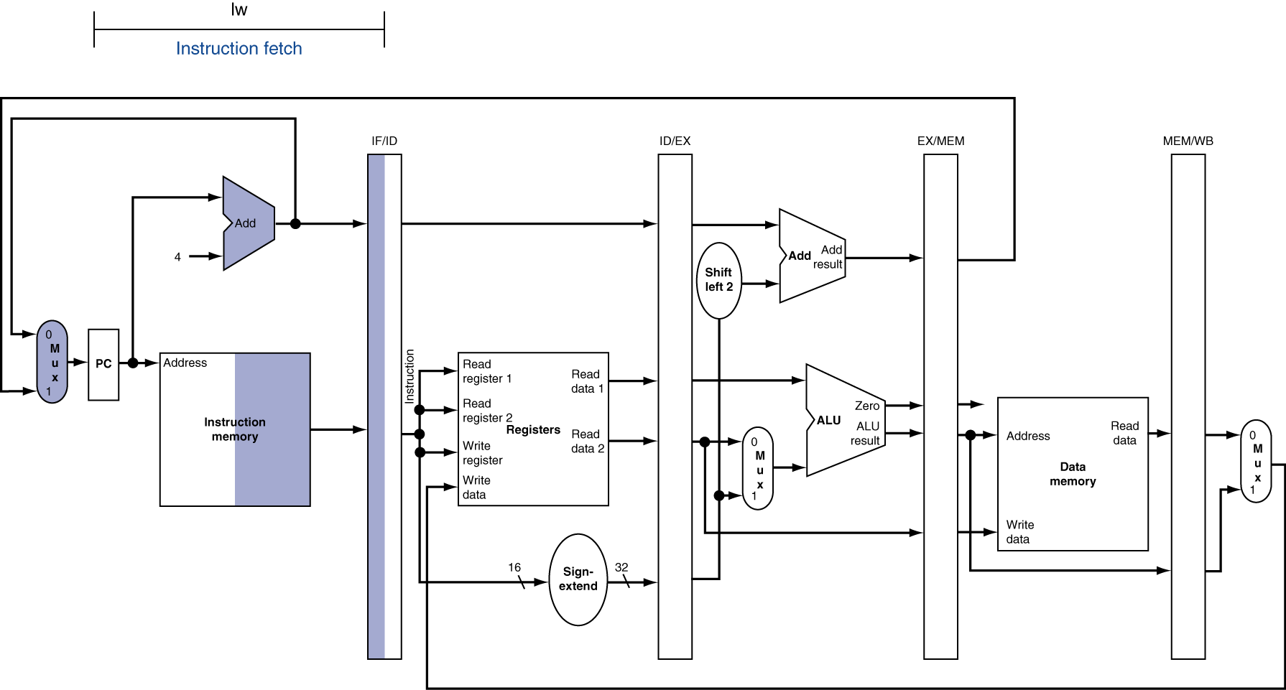
IF for Load, Store, …
Chapter 4 — Pipelining — <number>
Notes:
Morgan Kaufmann Publishers
Chapter 4 — The Processor

Slide 4
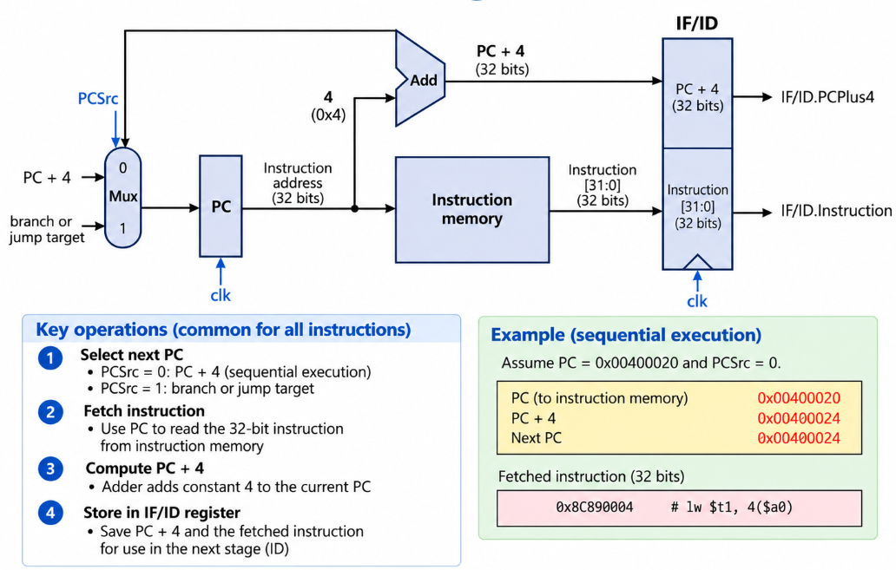
Instruction fetch (Cont.)
Chapter 4 — Pipelining — <number>

Slide 5
Instruction fetch (Cont.)
Q1. A lw instruction has just completed the IF stage.
Which information must be stored in the IF/ID pipeline register for the next stage?
ALU result and destination register number
B. Instruction and PC + 4
C. Memory read data and RegWrite
D. Register operands and sign-extended immediate
A1.
B. Instruction and PC + 4
Needed for decoding and register selection in ID.
PC + 4 is preserved for instructions in later stages.
Register operands and sign-extended immediate are generated during ID.
Chapter 4 — Pipelining — <number>

Slide 6
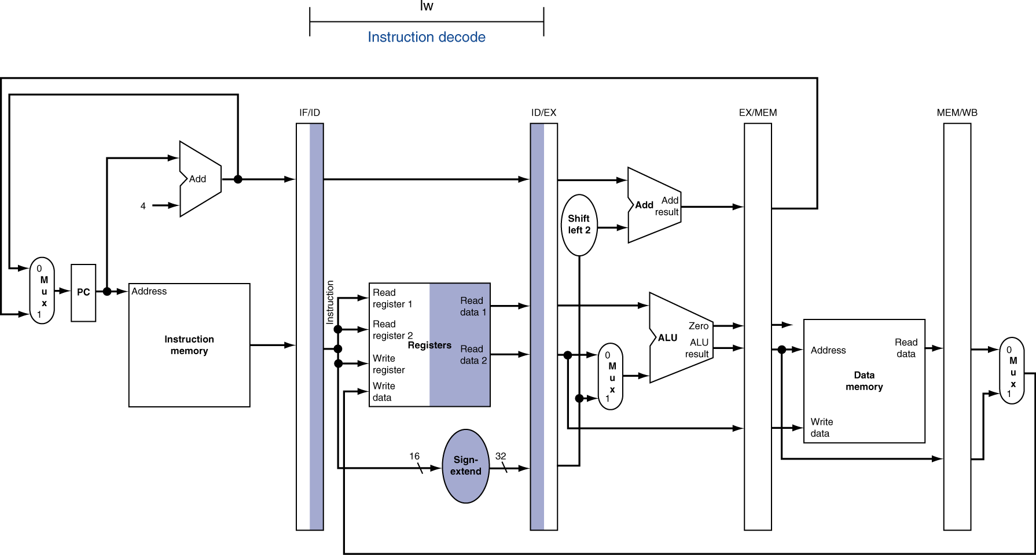
ID for Load, Store, …
Chapter 4 — Pipelining— <number>
Notes:
Morgan Kaufmann Publishers
Chapter 4 — The Processor

Slide 7
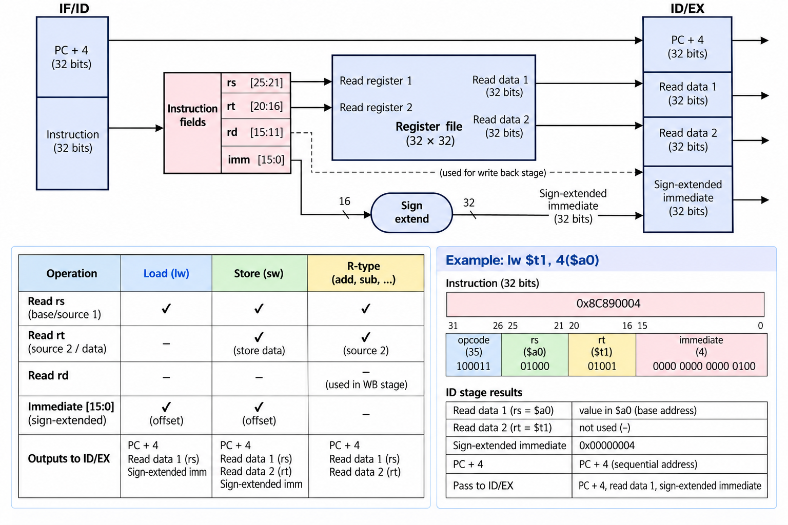
Instruction Decode (Cont.)
Chapter 4 — Pipelining — <number>

Slide 8
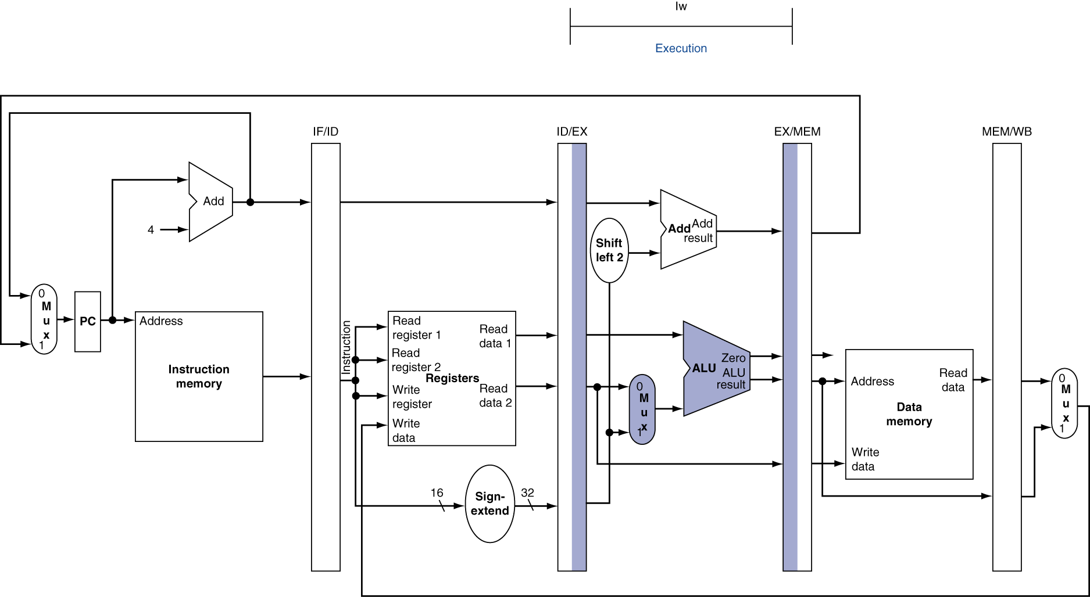
EX for Load
Chapter 4 — Pipelining — <number>
Notes:
Morgan Kaufmann Publishers
Chapter 4 — The Processor

Slide 9
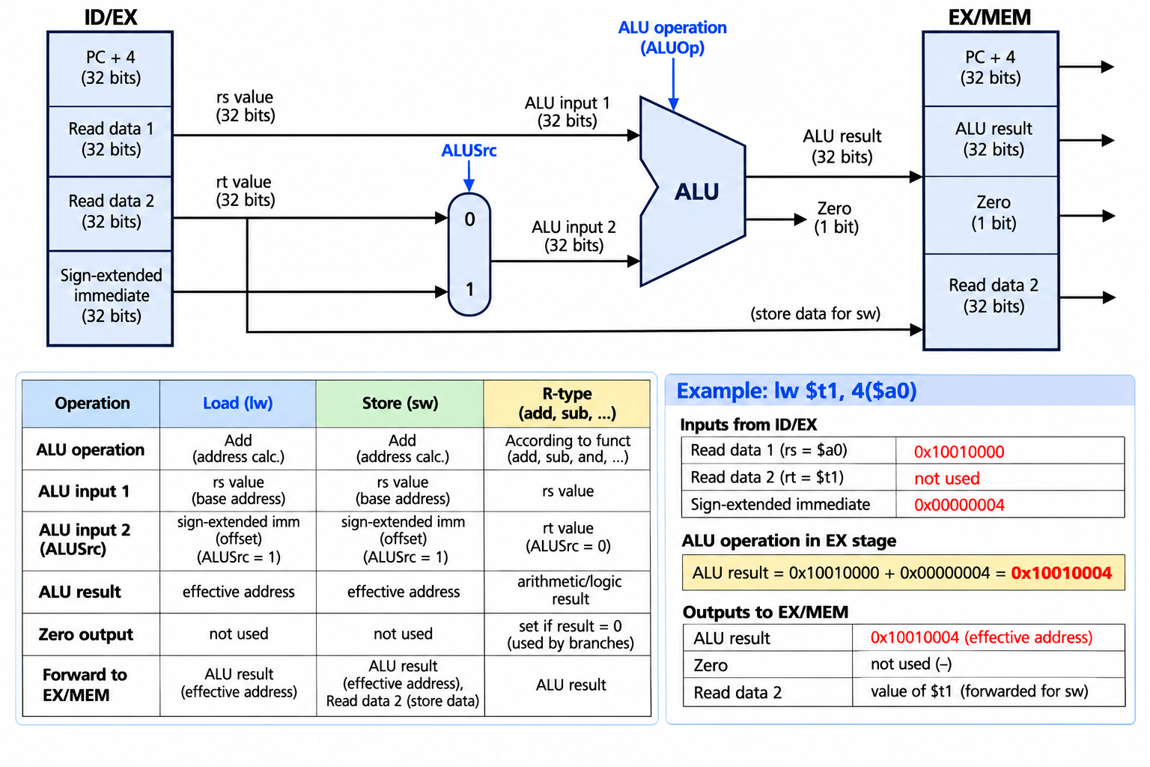
Execute (Cont.)
Chapter 4 — Pipelining — <number>

Slide 10
Execute (Cont.)
Q2. Consider the following two instructions:
lw $t0, 12($s1)
add $t2, $s1, $t3
Assume $s1 = 100 and $t3 = 25. For each instruction, determine the two ALU inputs, the value of ALUSrc, and the ALU result during the EX stage.
A2.
lw uses the base register and sign-extended immediate to calculate the effective address.
add uses two register operands to perform arithmetic.
Instruction | ALU Input 1 | ALU Input 2 | ALUSrc | ALU Result
lw | 100 | 12 | 1 | 112
add | 100 | 25 | 0 | 125
Chapter 4 — Pipelining — <number>

Slide 11
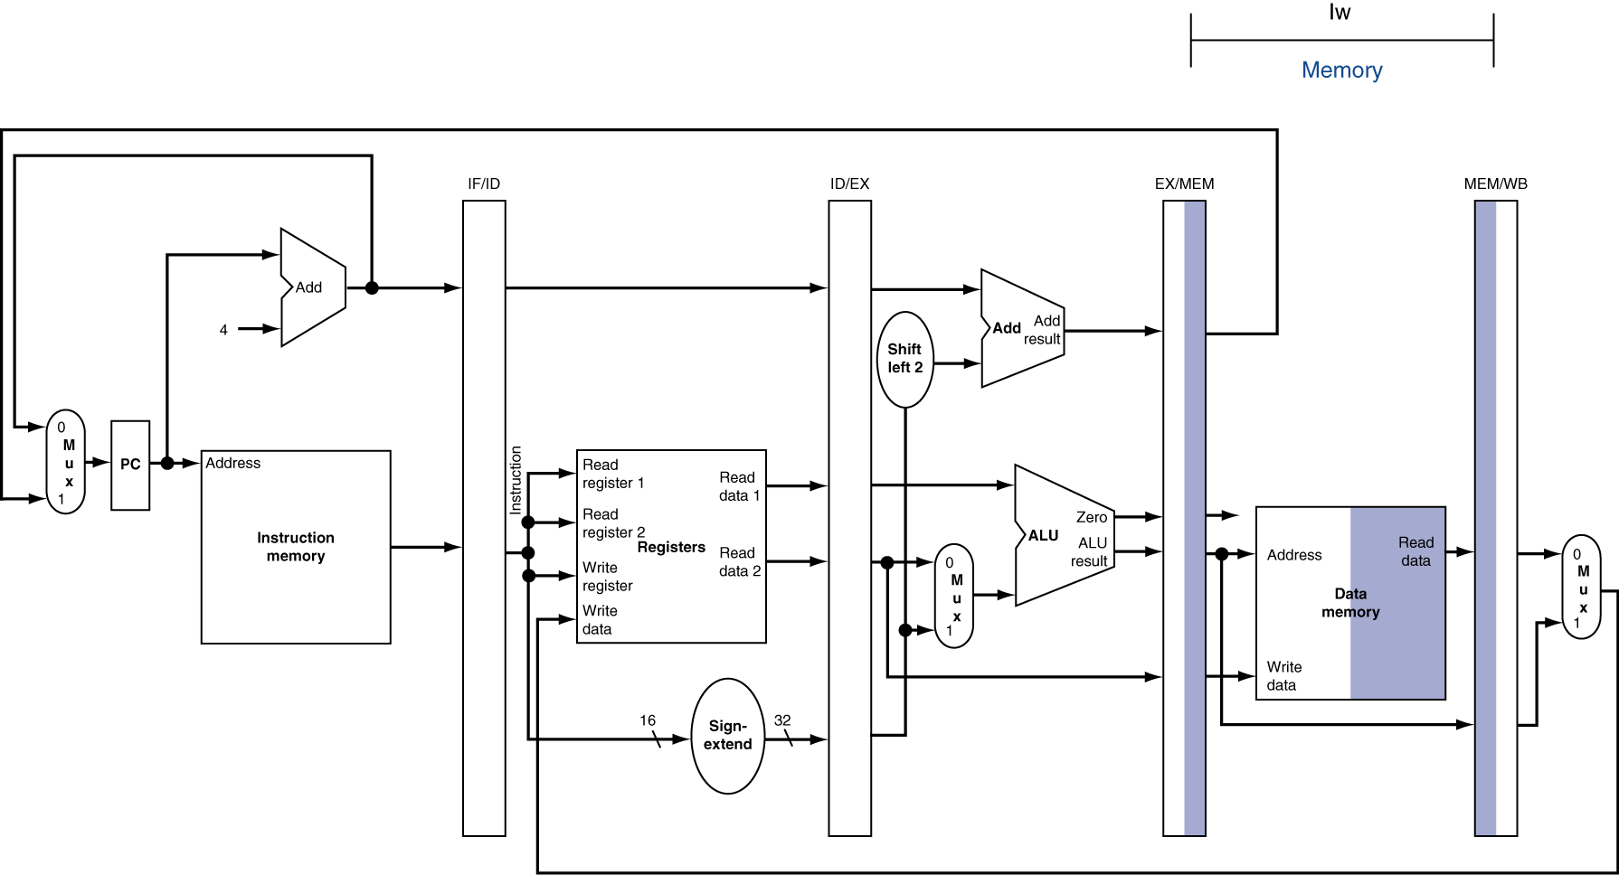
MEM for Load
Chapter 4 — Pipelining — <number>
Notes:
Morgan Kaufmann Publishers
Chapter 4 — The Processor

Slide 12
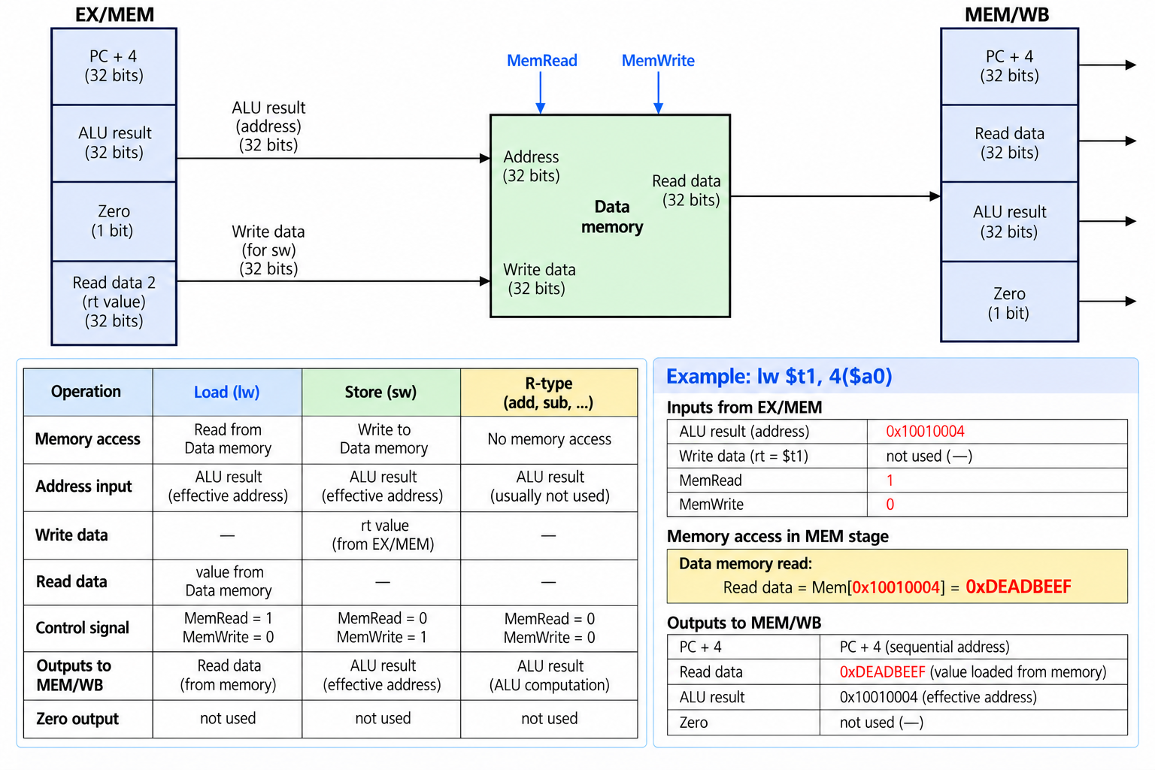
Memory Access (Cont.)
Chapter 4 — Pipelining — <number>

Slide 13
Memory Access (Cont.)
Q3. Which of the following are stored in the MEM/WB pipeline register? (Select all that apply.)
ALU Result
B. Memory Read Data
C. Sign-extended Immediate
D. Destination Register Number
E. MemtoReg
F. ALUSrcG. RegWrite
A3.
A, B, D, E, G
Chapter 4 — Pipelining — <number>

Slide 14
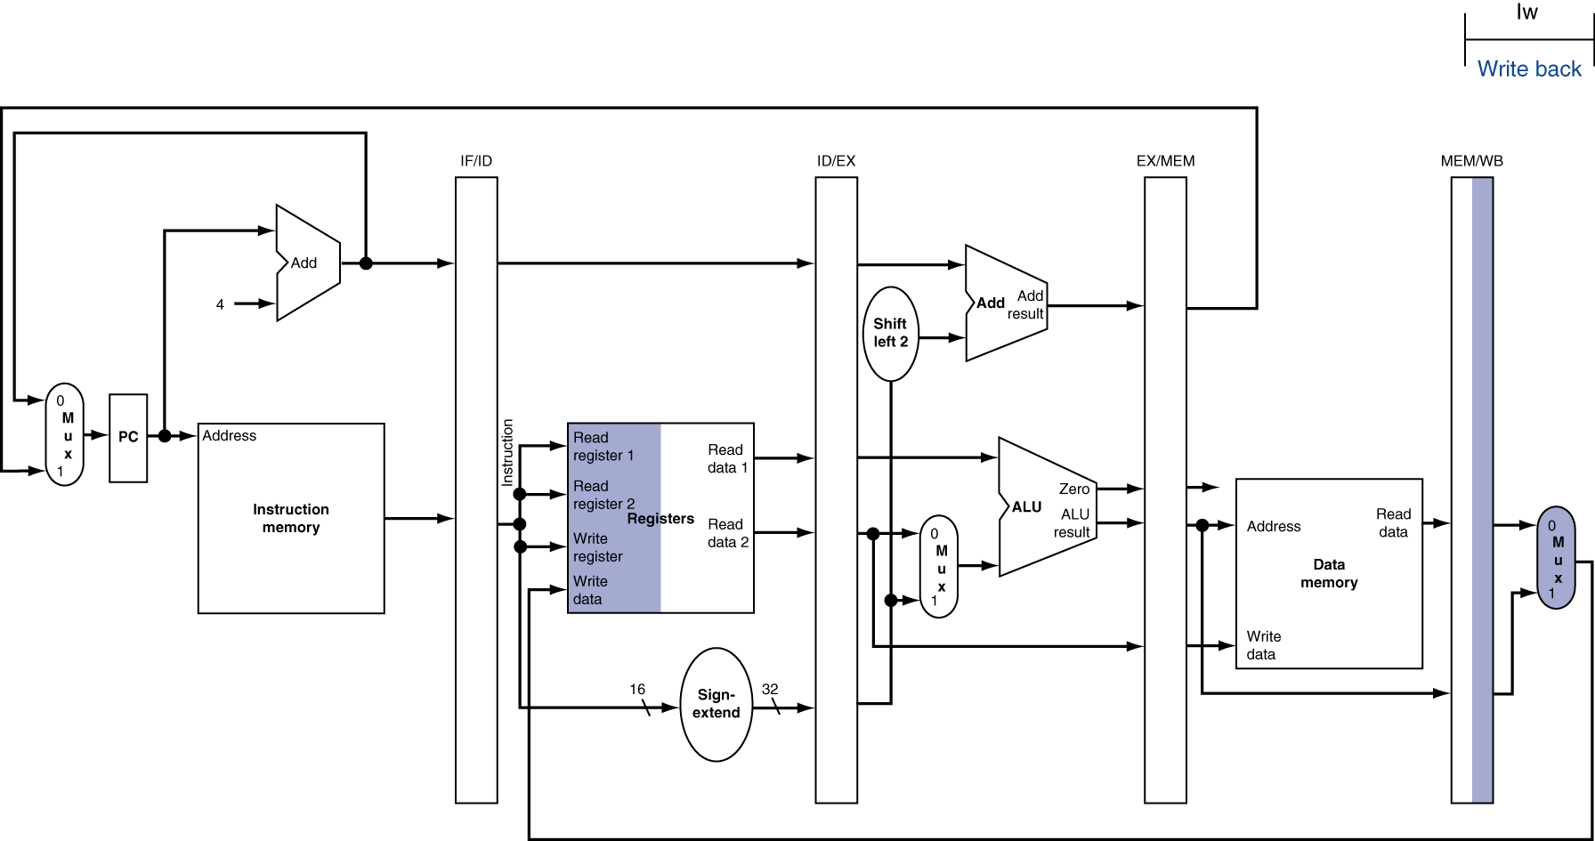
WB for Load
Wrong
register
number
Chapter 4 — Pipelining — <number>
Notes:
Morgan Kaufmann Publishers
Chapter 4 — The Processor

Slide 15
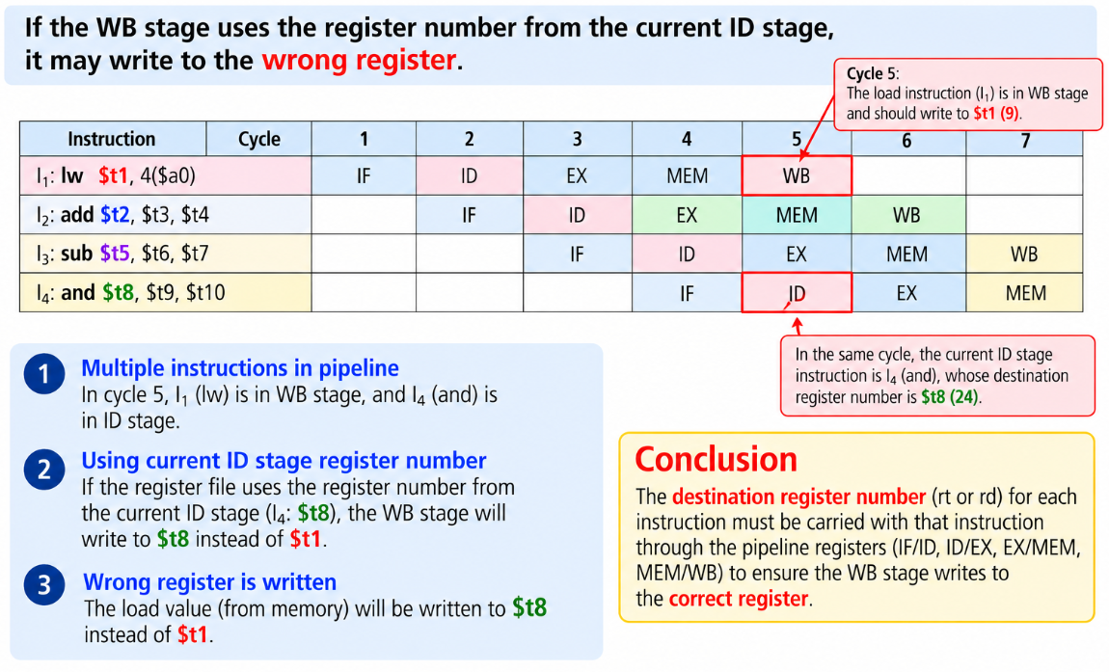
Wrong Register Number
Chapter 4 — The Processor — <number>

Slide 16
Wrong Register Number
Q4. Consider the following instructions in a five-stage pipeline without stalls
I1: lw $t1, 4($s0)
I2: add $t2, $s1, $s2
I3: sub $t3, $s3, $s4
I4: and $t4, $s5, $s6
When I1 reaches the WB stage, I4 is in the ID stage. If the destination register number is incorrectly taken from the current ID stage, which register will be written instead of $t1?
A4.
$t4
The WB stage would incorrectly use the destination register number of I4 ($t4). The correct destination register number ($t1) must travel with I1 through the pipeline registers.
Chapter 4 — The Processor — <number>

Slide 17
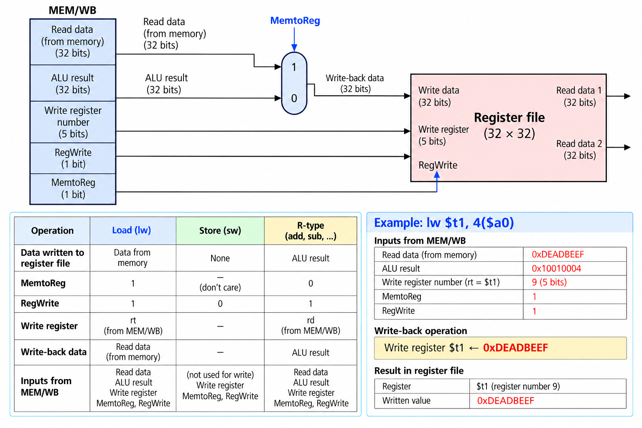
Write Back (Cont.)
Chapter 4 — Pipelining — <number>

Slide 18
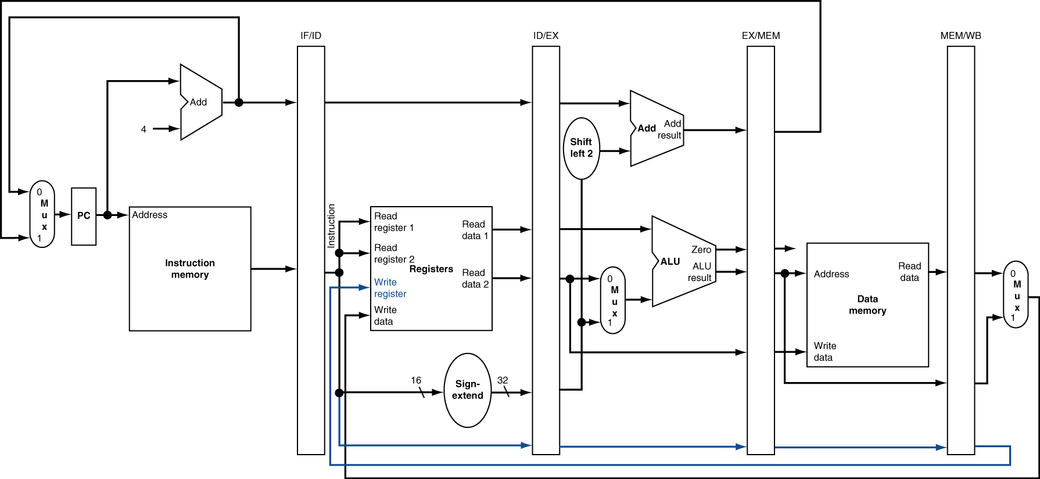
Corrected Datapath for Load
Chapter 4 — Pipelining — <number>
Notes:
Morgan Kaufmann Publishers
Chapter 4 — The Processor

Slide 19
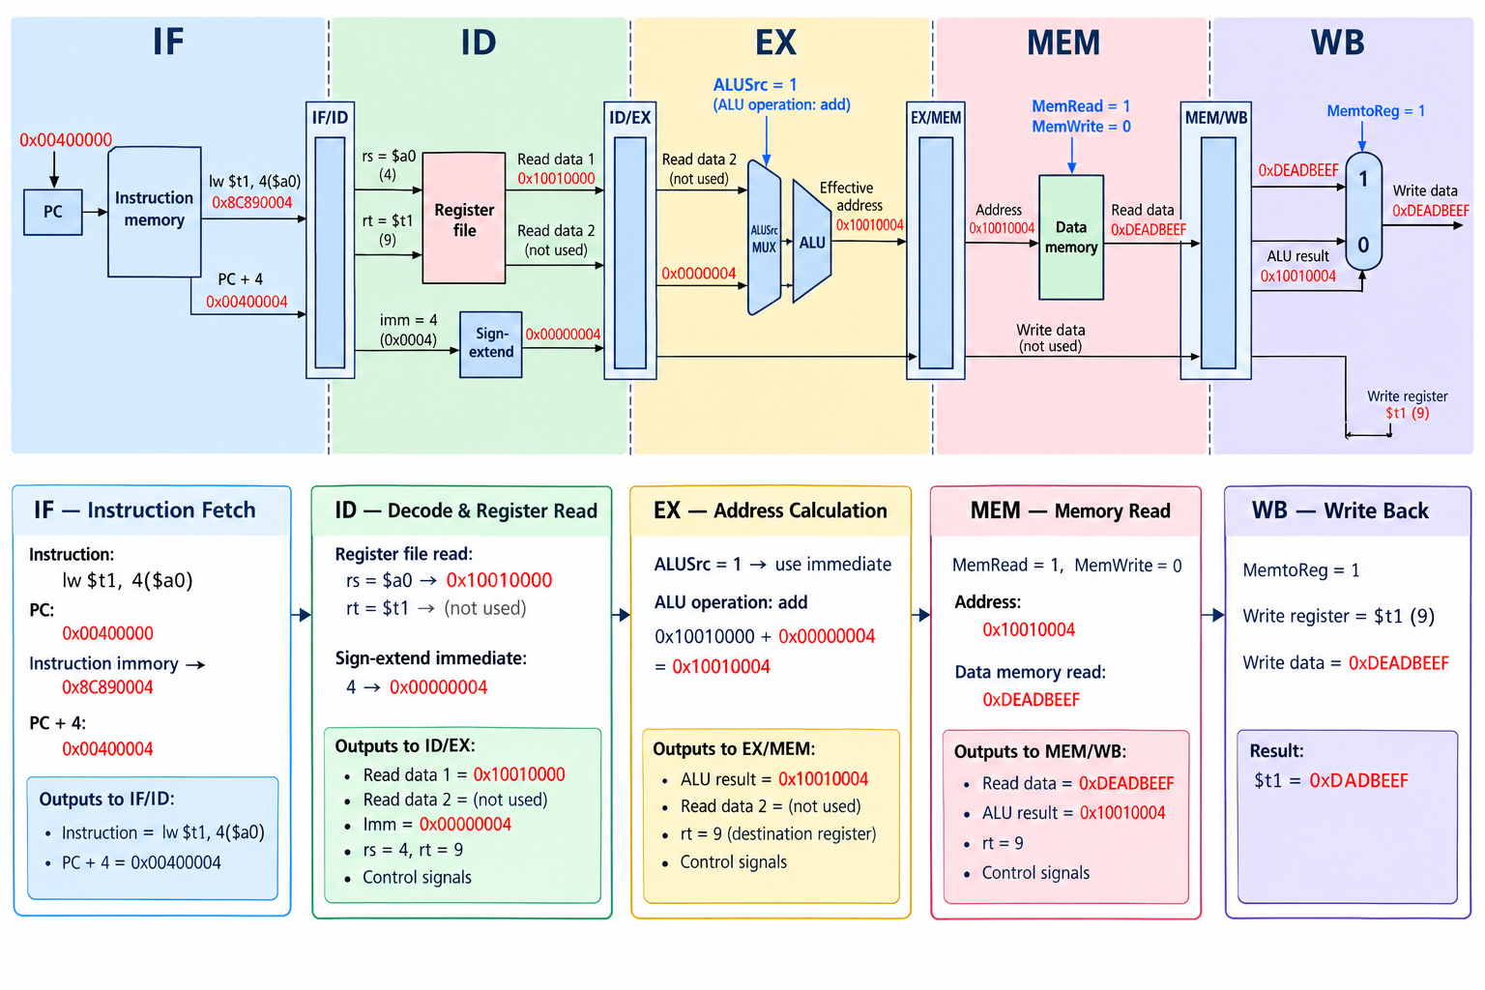
Complete Load Inst. Tracing
Chapter 4 — The Processor — <number>

Slide 20
Complete Load Inst. Tracing
Q5. Consider the following instruction: lw $t2, 8($s0)
Assume $s0 = 0x10010000 and Memory[0x10010008] = 0x0000002A. Complete the pipeline tracing table.
A5.
Stage | Operation / Result
IF | Fetch the instruction
ID | Read $s0 = ?
EX | Effective Address = ?
MEM | Memory Read Data = ?
WB | Register Updated = ?
Stage | Operation / Result
IF | Fetch lw $t2, 8($s0)
ID | 0x10010000
EX | 0x10010008
MEM | 0x0000002A
WB | $t2 = 0x0000002A
Chapter 4 — The Processor — <number>

Slide 21
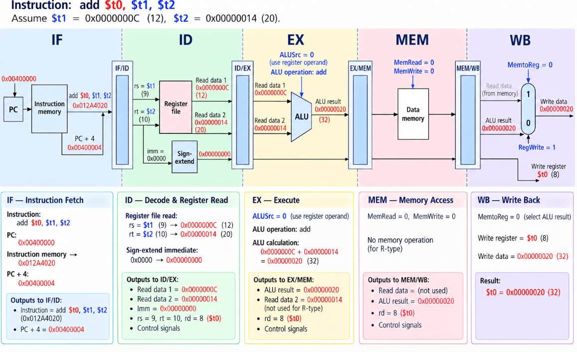
Complete R-format Instruction
Chapter 4 — The Processor — <number>

Slide 22
Section 4-2 Quick Questions
Q1.
What information must be stored in the IF/ID pipeline register?
Q2.
For lw and add, determine the ALU inputs, ALUSrc, and ALU result.
Q3.
Which data and control signals are stored in the MEM/WB pipeline register?
Q4.
If WB incorrectly uses the destination register number from ID, which register will be written?
Q5.
Trace a lw instruction through all five pipeline stages and determine the results.

Slide 23
Exercise 1 — Pipeline Register Consistency
Consider three instructions in a five-stage pipeline:
I1: lw $t0, 8($s0)
I2: add $t1, $s1, $s2
I3: sub $t2, $s3, $s4
ID/EX
EX/MEM
MEM/WB
I3
I2
I1
EX/MEM contains ALU Result = 45, but its destination register number is $t2. Identify the incorrect field and provide the correct value.
Answer
Incorrect field: EX/MEM destination register number.
Correct value: $t1 (the destination register of I2).
Data and register numbers must belong to the same instruction.
Key Point:

Slide 24
Exercise 2 — Pipeline Stage Timing
Consider a five-stage pipeline without stalls or forwarding:
I1: add $t0, $s0, $s1
I2: sub $t2, $t0, $s2
I3: and $t3, $s3, $s4
When I2 is in the ID stage, identify the stages occupied by I1 and I3. Has I1 already written its result to $t0?
Explain your answer based on the five-stage pipeline sequence.
Answer
I1: EX; I2: ID; I3: IF.
No. I1 writes $t0 during WB, which occurs later.
Instructions overlap in different stages; WB occurs after EX and MEM.
Key Point:

Slide 25
Exercise 3 — Reverse Pipeline Reasoning
The following values are observed for one instruction:
EX: ALU Result = 0x10010014
MEM: Memory Read Data = 0x00000064
WB: $t5 receives 0x00000064
Assume $s0 = 0x10010000. Determine the instruction type, destination register, and immediate offset.
Write the complete MIPS instruction.
Answer
Instruction: lw $t5, 20($s0)
Offset = 0x14 = 20; destination register = $t5.
EX, MEM, and WB results can reveal the original load instruction.
Key Point:

